Slide 1
Students’ Early Attrition Modelling for Clearwater State University
Capstone Project Analysis Report
From: Chethan Kumar R
Jig20517

Slide 2
Contents
Problem Statement.
Analytical Approach.
Packages Utilized.
Data Preparation.
Data Summary.
Exploratory Data Analysis.
EDA on Student Demographic Data.
EDA on Student Performance Data.
EDA on Student Financial Data.
Model Building & Validation.
Key Drivers of Attrition.
Recommendations.

Slide 3
Problem Statement
Clearwater State University offers a wide variety of degree programs, from online degrees to a doctorate in education.
Some key strategic goals of the University are:
Increase enrolment of students.
Improve retention, progression and graduation rates.
Recruit better academically qualified undergraduate and graduate students
Increase external funding and recognition.
In order to achieve the above said goals, one approach is to build a predictive model by leveraging data on student profile.

Slide 4
Analytical Approach/Solution
The Following Steps are followed in order to get the attrition rate and important variables driving the attrition in the university:-
Leverage data on student segments namely demographic profile, course preferences, performance record & financial background.
Exploratory Data Analysis on each segments showing key associations.
Segment Analysis showing key drivers of attrition.
Building predictive model to identify students with higher early attrition risk.
Results of statistical model along with business interpretations and recommended interventions.

Slide 5
Packages Utilized
Python is used as Primary Tool for EDA and Modelling.
For Data library Excel sheets are utilized.
Packages such is pandas, numpy, & matplotlib seaborn etc.
Modelling algorithms such as Gradient Boosting Classifier is used for Attrition Rate Prediction.

Slide 6
Data Preparation
Data Preparation involves
Cleaning the data for missing value treatment.
Outliers detection & treatment.
Removal of unrealistic data.
For the given dataset the above steps are followed before modelling.

Slide 7

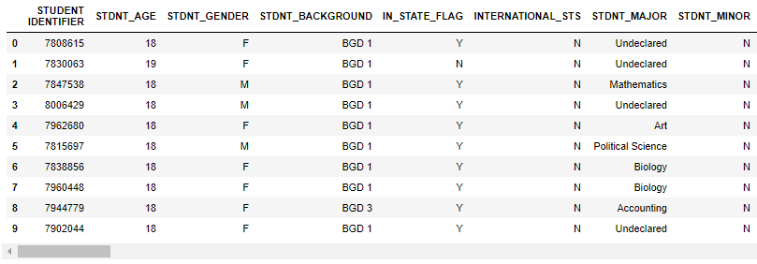
Data Preparation
Dataset contains records of 3400 students with 56 variables (3400 Rows and 56 Columns).
Table showing first 10 observations of the dataset.

Slide 8
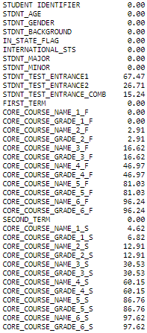
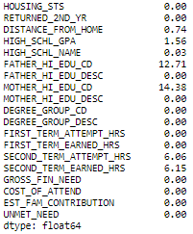
Data Preparation
From the output it is evident that few columns of the dataset has missing values.
All the values are in percentage.
Example:
STDNT_TEST_ENTRANCE1 has 67.47% Missing values.
DISTANCE_FROM_HOME has 0.74% Missing values.
As a Next step of data preparation, Dropping Columns with more than 20% missing values
Output

Slide 9
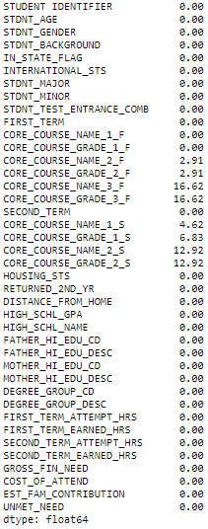
Data Preparation
Output
After dropping 20% of the missing values , still there is an missing values in the certain columns as shown in the output.
Filling these missing values in columns 'HIGH_SCHL_GPA','FATHER_HI_EDU_CD','MOTHER_HI_EDU_CD','SECOND_TERM_ATTEMPT_HRS' & 'SECOND_TERM_EARNED_HRS' with mean values of their respective columns.
Still there is an missing value columns in the dataset after following above steps.

Slide 10
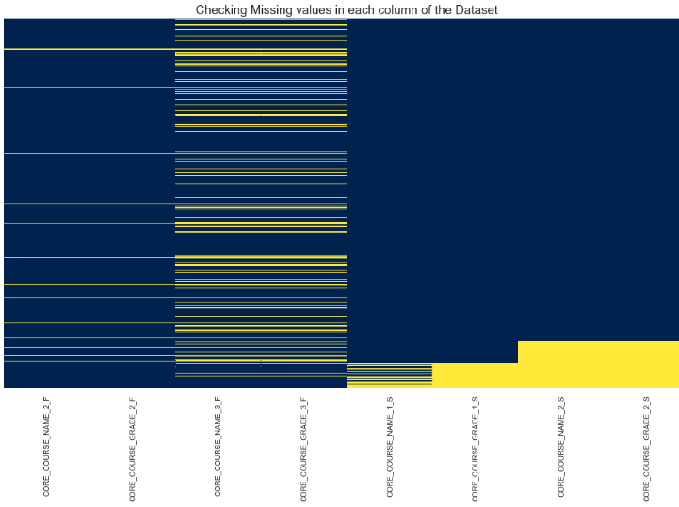
Data Preparation
Checking for remaining missing value columns graphically.
There seems to be few missing observations in the columns like CORE_COURSE_NAME_3_F,
CORE_COURSE_GRADE_2_S etc with few Categorical observations in Nature.
Output

Slide 11
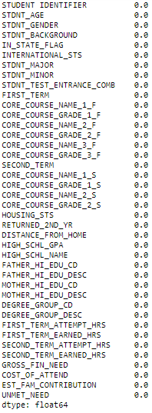
Data Preparation
Output
One approach to imputing categorical features is to replace missing values with the most common class.
After all the missing and outliers treatment from the output it is evident that there is no missing values in the dataset.
Now the dataset is ready for further EDA and Modelling.

Slide 12
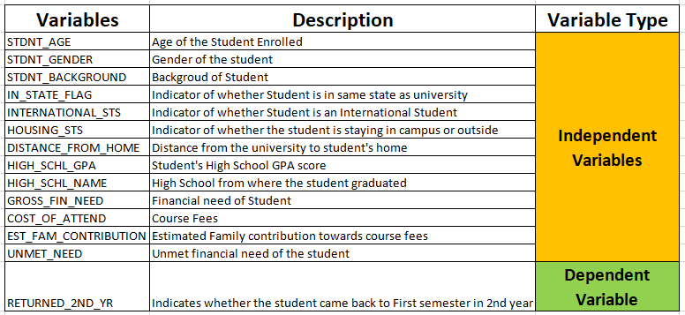
Data Summary
Sample Snip (Data Dictionary)
Let's take few minutes in understanding available students data.
Dependent variable: ‘RETURNED_2ND_YR’
Early attrition is defined as student drop out within one year of successfully joining the program (completed admission process). Here dependent variable is “ RETURNED_2ND_YR”.
Note:
Here “0” represents Students who didn’t came back to First Semester in 2nd Year, “1” represents student came back to First semester in 2nd Year, in the “ RETURNED_2ND_YR” Column.

Slide 13
Exploratory Data Analysis (EDA)
In order to get better understanding and insights on how Each Independent variable is related to Dependent variable EDA is performed.
EDA is performed on all the variables in the dataset.
In this Assignment EDA is done based on 3 Major segments: -
EDA on Students Demographic Data.
EDA on Students Performance Data.
EDA on Students Financial Data .
Details on the above analysis can be seen in the coming slides.

Slide 14
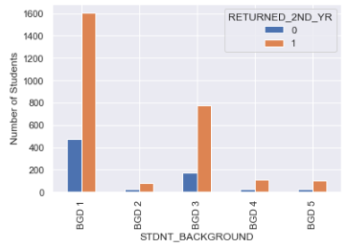
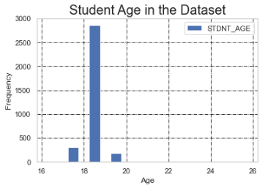
EDA on Student Demographic Data
STDNT_BACKGROUND
STDNT_AGE
From the graph it is seen that student with ‘BDG1’ has most number of ‘student drop out’.
From the graph it is evident that majority of the students fall under the age group between 18 to 20 years.

Slide 15
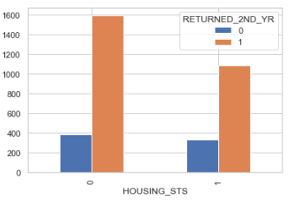
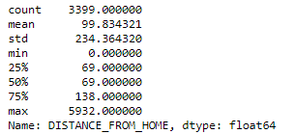
EDA on Student Demographic Data
HOUSING_STS
DISTANCE_FROM_HOME.
Bar graph indicates student drop outs are almost similar in numbers between off and on campus students.
From the data description student stay with the mean distance of 99.83 kms

Slide 16
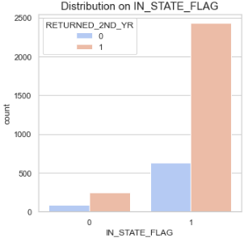

EDA on Student Demographic Data
IN_STATE_FLAG
INTERNATIONAL_STS.
From crosstab, International Student has less drop outs.
From chart, Student who stays in same state as university has considerable amount of students drop outs.

Slide 17

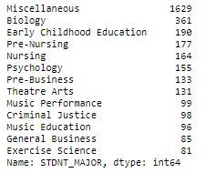
EDA on Student Performance Data
STDNT_MAJOR
STDNT_MAJOR has 54 unique values.
Replacing those categorical variable name whose number of counts are less than 80 with 'Miscellaneous' in STDNT_MAJOR column.
Now the STDNT_MAJOR column has 13 unique values, which helps in better EDA on this column.

Slide 18
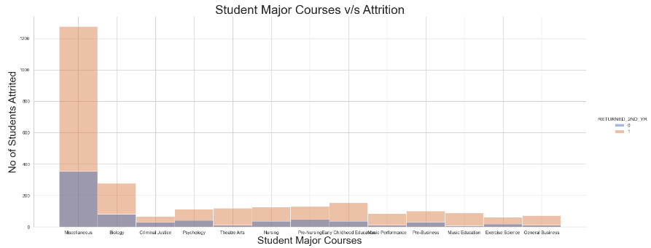
EDA on Student Performance Data
STDNT_MAJOR
Since Miscellaneous is a combination of other subjects.
Students with the Biology background seems to be higher in attrition rate, proper focus needs to be given to these students in order to control the attrition rate.

Slide 19
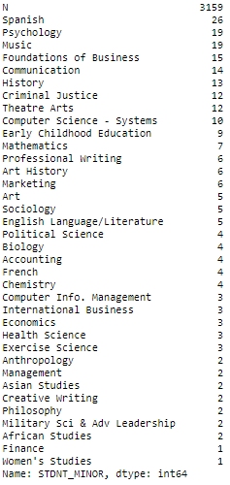
EDA on Student Performance Data
STDNT_MINOR
From the Output for variable STDNT_MINOR it is evident that, there is 3159 Student's with Minor course ‘N’ in University.
Assuming that there is no 'N' minor subject, dropping the column ('STDNT_MINOR').
Insights from this column with respect to attrition is not feasible.

Slide 20
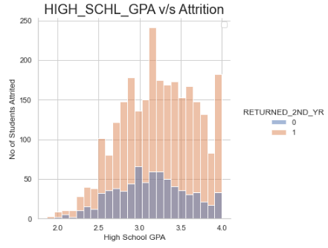
EDA on Student Performance Data
HIGH_SCHL_GPA
From the output table, Attrition is decreasing as the High school GPA score increases hence it is better to admit students with better high school GPA, and proper assistance should be given to students with lower High school GPA score.
Also Dropping variables 'HIGH_SCHL_NAME' & 'DEGREE_GROUP_CD' from Student performance data as these variables does not provide any information regarding attrition.

Slide 21
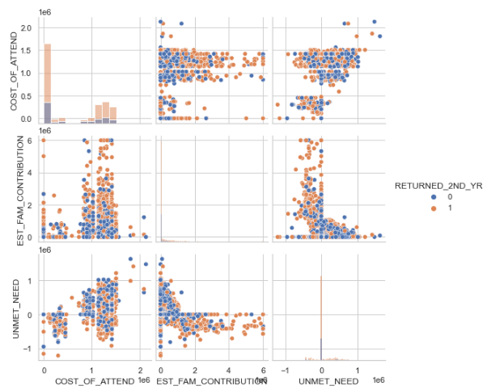
EDA on Student Financial Data
Comparing UNMET_NEED, EST_FAM_CONTRIBUTION & COST_OF_ATTEND.
From the pair plots , if the ‘EST family contribution’ decreases there is increase in attrition rate.

Slide 22
Model Building & Validation
For this Attrition Model, Gradient Boosting Classifier algorithm is utilized.
Missing value treatment and dummy variables are created for categorical variables.
Test train split is imported from Sklearn Model selection module
Data split into Test and Train with 80% for testing and 20% for training dataset.
Model build to obtain the important variables from Gradient Boosting Classifier
Model obtained Accuracy of 84.26 %.

Slide 23
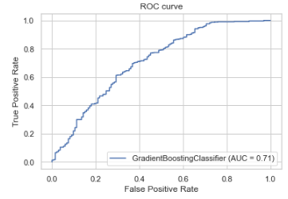

Model Validation
Model validation is done with ROC Curve and Confusion Matrix which are shown below.
Confusion Matrix Interpretation:
True Positives = 39
False Positives = 13
False Negatives = 94
True Negatives = 534
From the confusion matrix, model has predicted 534 & 39 values correctly also 13 & 94 as false predictive values.
From the Boosting Classifier Area Under the Curve is 0.71, which means model is performing well in predicting the values.

Slide 24
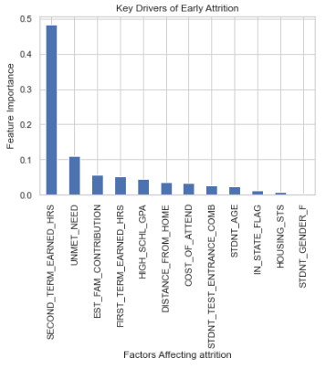
Key Drivers of Attrition
Top 5 Key Drivers of the Attrition is shown in the output table.
SECOND_TERM_EARNED_HRS
Students with high grade points in the Second semester tend to stay back than from those who are not.
UNMET_NEED
Students who stay back are lesser unmet needs compared to the ones who leave.
EST_FAM_CONTRIBUTION
If the Estimated Family contribution towards course fees is higher, then the respective student is more likely to stay back.

Slide 25
Key Drivers of Attrition
Top 5 Key Drivers of the Attrition is shown in the output table.
FIRST_TERM_EARNED_HRS
Students with high grade points earned First semester are more likely stay back than from those who are not.
HIGH_SCHL_GPA
Student's with higher High School GPA score are more likely stay back than students who tend to leave.

Slide 26
Recommendations
Important recommendations are given below in order to reduce the University students attrition rate.
It can be noted from the model, second term earned hrs/Grade points is the key driver of attrition so it is better to give more attention to students who get less Grade points earned by Student in Second semester.
UNMET_NEED & EST_FAM_CONTRIBUTION of the student also plays important role in students attrition. Students with higher unmet financial need tend to leave the course, so proper financial assistance to be provided in terms of scholarships & other financial aids.
Student's with higher High School GPA score are more likely stay back than students who tend to leave. So its better to admit the students with higher high school GPA by setting up cut off limit at the time of admission.
Students with above said background should be given special attention in terms of Grade points, Unmet financial needs and High school GPA, in order to maintain low attrition rate in the university.

Slide 27
Thank You

